Slide 1
Customer-experience enhancement system
Team Dinosaur: Satyajeet Das, Soumya Dash & Qiao Xu

Slide 2
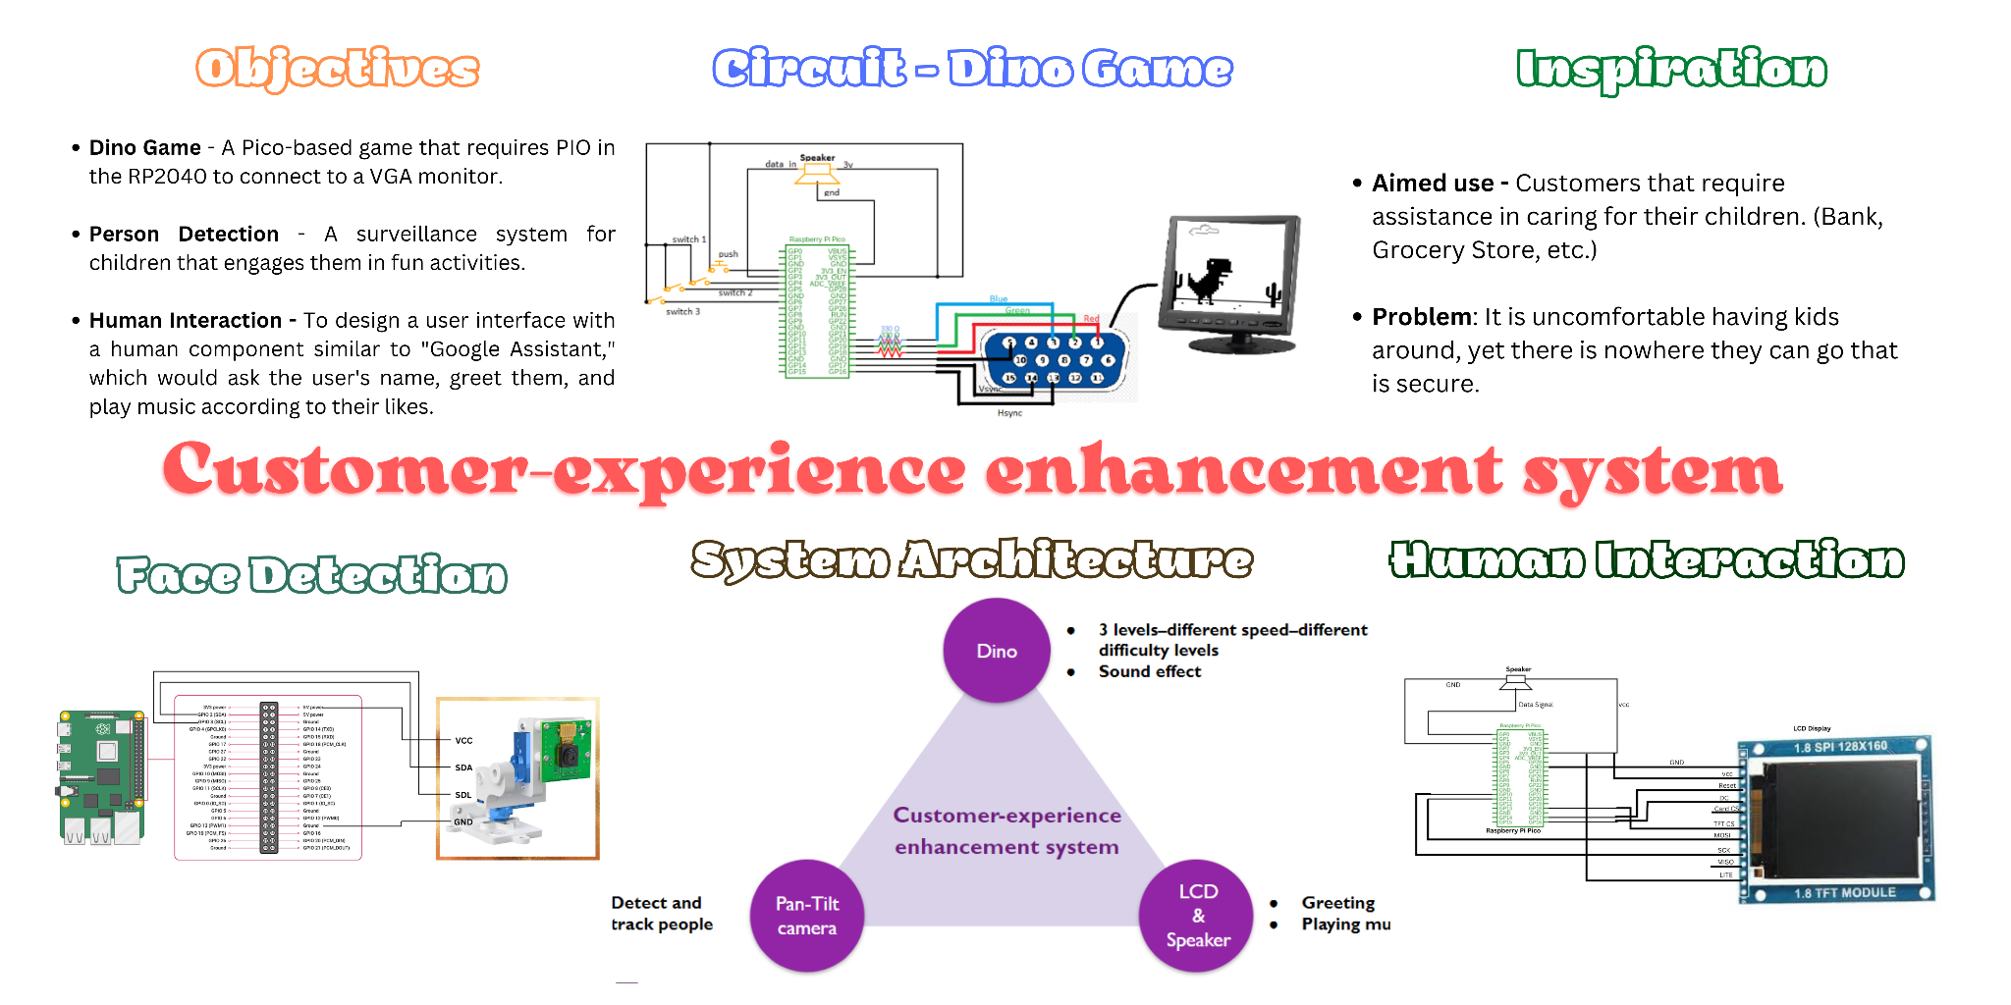
Final Project

Slide 3
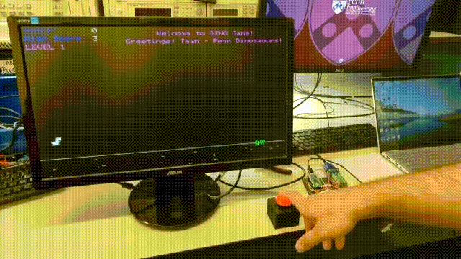
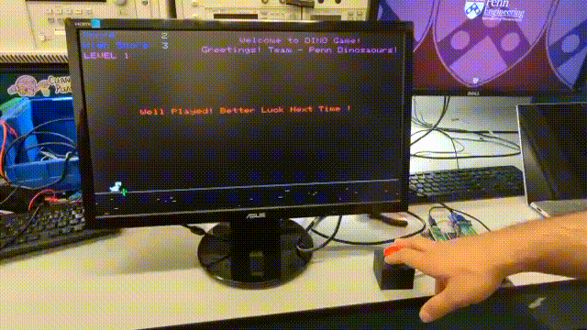
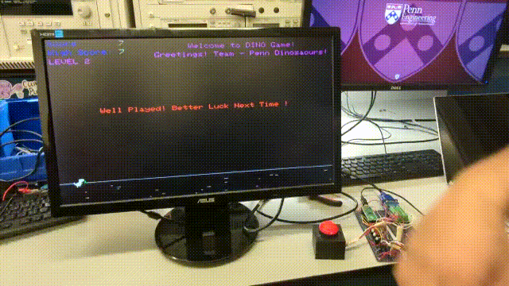
Demo show(Dino game)
Level 1
Level 2
Level 3

Slide 4
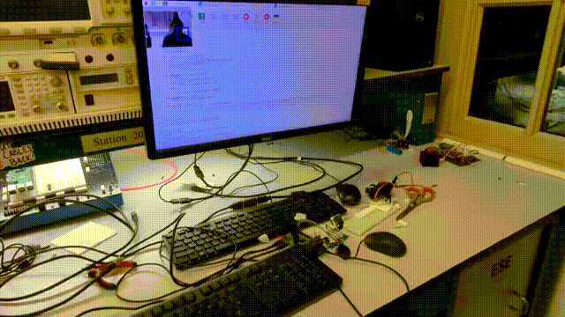
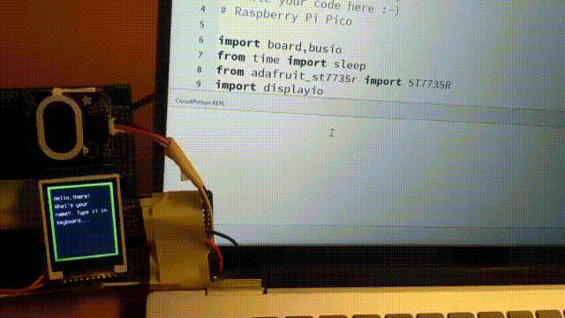
Demo show(Face detection; LED+speaker)
Face detection
LCD + Speaker

Slide 5
Thank You !!!

